Slide 1
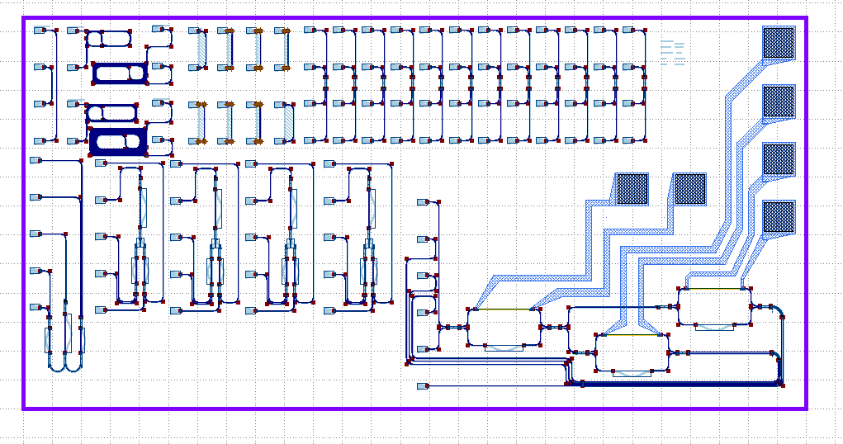
Hamish Design V1

Slide 2
Length Test
R_bend Test
Directional Coupler Testers
LoopBack
MZI Testers
MZI with heaters

